Slide 1

NATIONAL INSTITUTE OF TECHNOLOGY WARANGAL
PROJECT WORK - B
ENERGY THEFT DETECTION USING MACHINE LEARNING AND DEEP LEARNING TECHNIQUES
Supervised by
Prof. M. Sailaja Kumari
Presented by
Kruthi pranada (202218)
Raghav Rath (202249)

Slide 2
INTRODUCTION
The objective of electricity theft detection is to detect unusual activities in the electricity usage of a smart meter.
Theft can be detected by checking for abnormalities in the user’s electricity consumption patterns.
The worst-hit are the developing economies.
Power theft and its illegal consumption results in immense economic loss for many countries such as India Rs 3,000 crores annually.
Power utilities are losing about 21 Billion Dollars globally, as power theft every year.

Slide 3
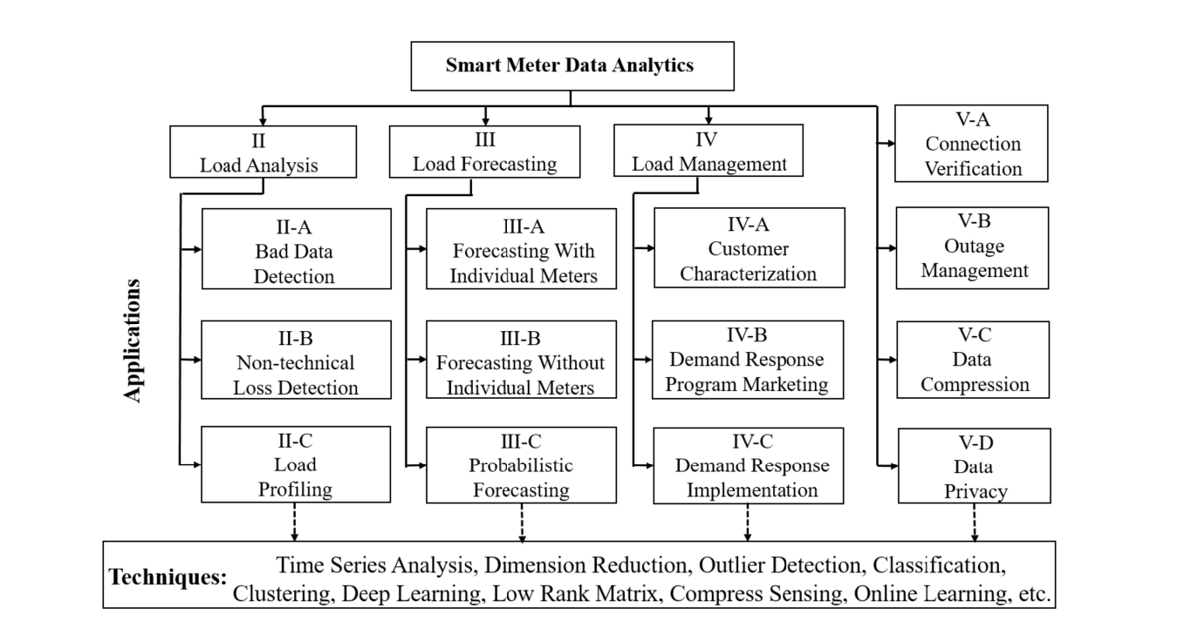
Y. Wang, Q. Chen, T. Hong, and C. Kang, “Review of Smart Meter Data Analytics: Applications, Methodologies, and Challenges,” in IEEE Transactions on Smart Grid, vol. 10, no. 3, pp. 3125-3148, May 2019, doi: 10.1109/TSG.2018.2818167.
https://ieeexplore.ieee.org/abstract/document/8322199

Slide 4
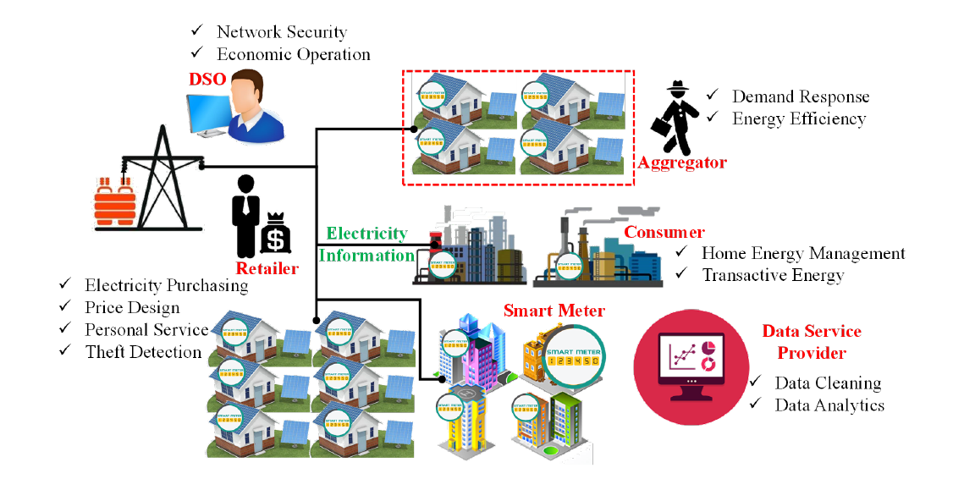
Y. Wang, Q. Chen, T. Hong, and C. Kang, “Review of Smart Meter Data Analytics: Applications, Methodologies, and Challenges,” in IEEE Transactions on Smart Grid, vol. 10, no. 3, pp. 3125-3148, May 2019, doi: 10.1109/TSG.2018.2818167.
https://ieeexplore.ieee.org/abstract/document/8322199

Slide 5
CONTENTS
INTRODUCTION
DATA SUMMARY
DATA ANALYSIS
DATA COLLECTION
MODELLING
CONCLUSIONS
FUTURE SCOPE
REFERENCES

Slide 6
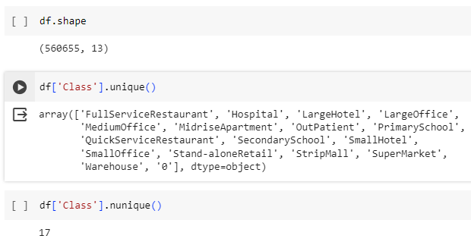
DATA SUMMARY
Data Statistics:
No of consumer types: 17
No of records: 5,60,655
No of features: 13
Columns Derived:
Total Energy
New Theft (Label)
S. Zidi, A. Mihoub, S. M. Qaisar, M. Krichen, and Q. Abu Al-Haija, “Theft detection dataset for benchmarking and machine learning based classification in a smart grid environment,” in Journal of King Saud University – Computer and Information Sciences, Received 21 February 2022, Revised 12 April 2022, Accepted 11 May 2022, Available online 17 May 2022.
https://www.researchgate.net/publication/360554845_Theft_Detection_Dataset_for_Benchmarking_and_Machine_Learning_based_Classification_in_a_Smart_Grid_Environment
DATASET:
https://data.mendeley.com/datasets/c3c7329tjj/1

Slide 7
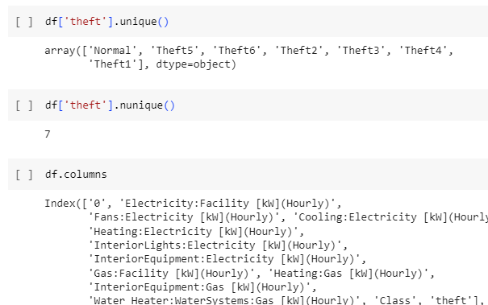
DATA SUMMARY
Theft types:
Theft 1: Considerable reduction of electricity consumption during the day.
Theft 2: Electricity consumption drops to zero at random and during an arbitrary period.
Theft 3: Consumption value (each hour) is multiplied by a random number.
Theft 4: A random fraction of the mean consumption.
Theft 5: The mean consumption.
Theft 6: Reverses the order of readings.

Slide 8
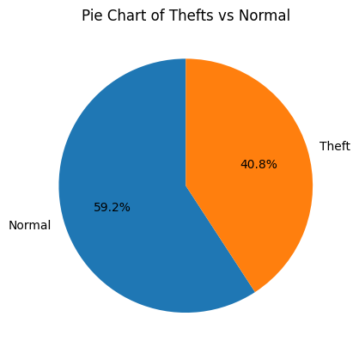
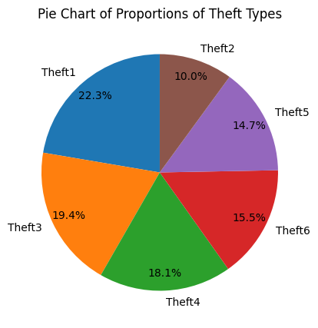
DATA ANALYSIS

Slide 9
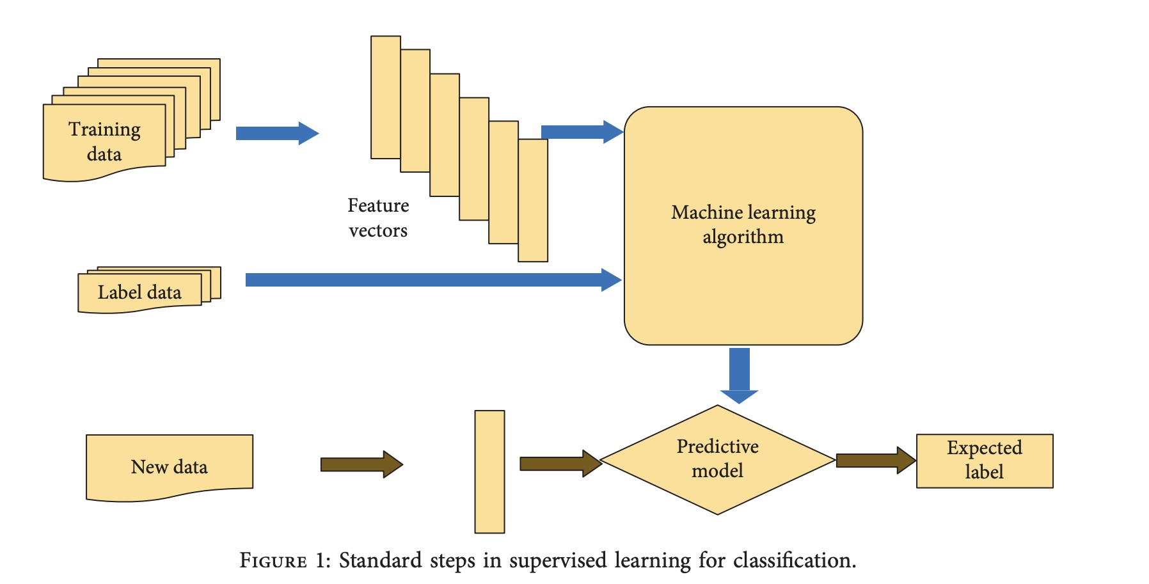

Slide 10
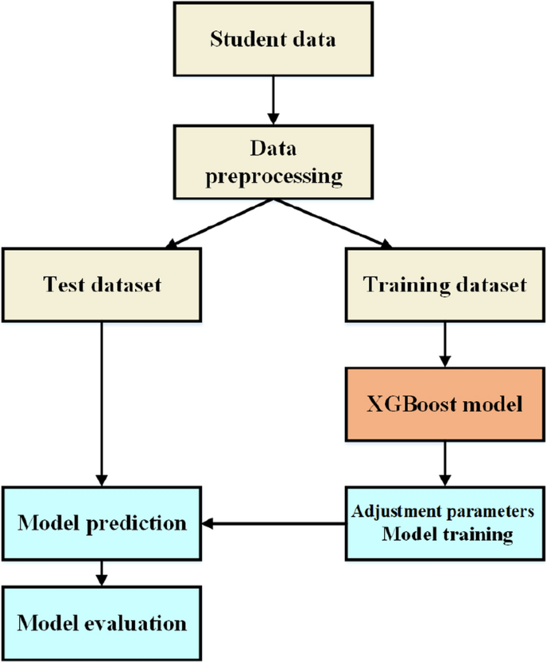
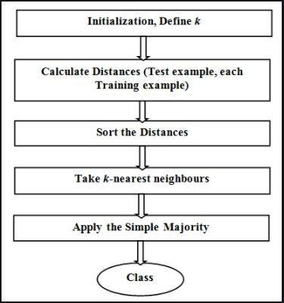
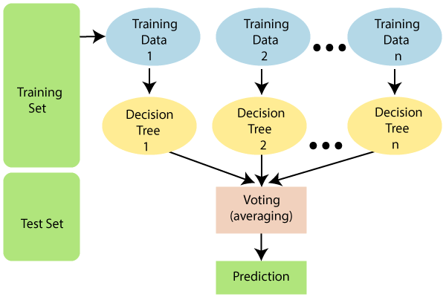
RANDOM FOREST
CLASSIFIER
XGBOOST
CLASSIFIER
KNN
CLASSIFIER

Slide 11
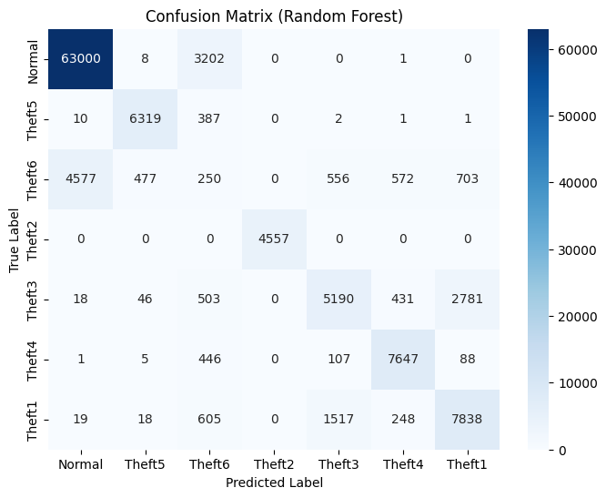
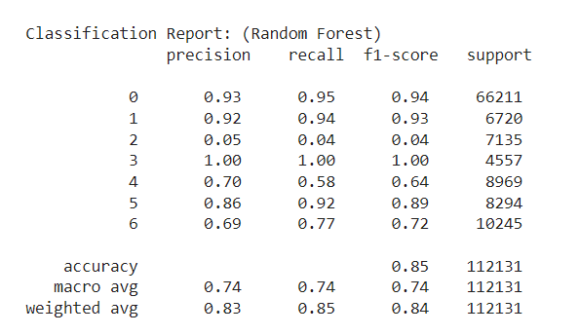
MODEL RESULTS (RANDOM FOREST)
Prediction on the test data

Slide 12
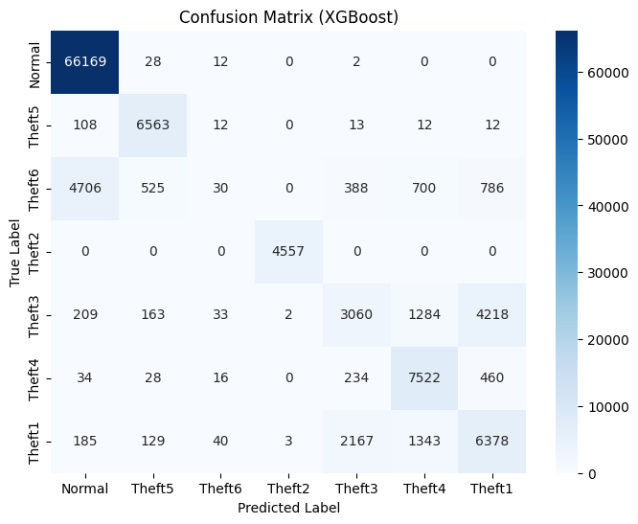
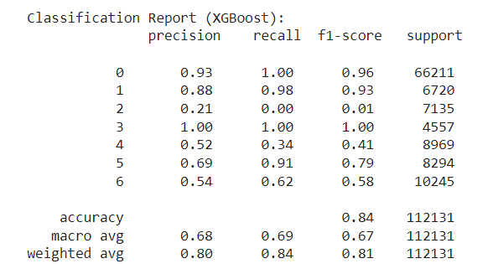
MODEL RESULTS (XGBoost)
Prediction on the test data

Slide 13
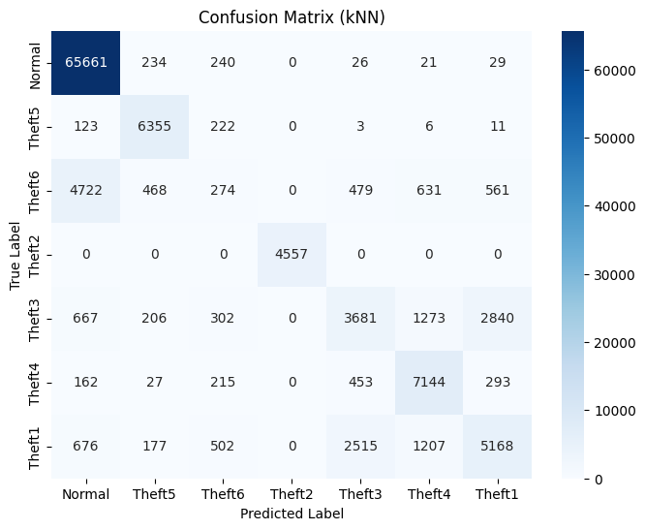
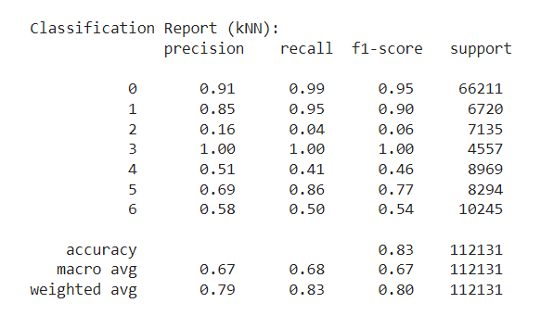
MODEL RESULTS (kNN)
Prediction on the test data

Slide 14
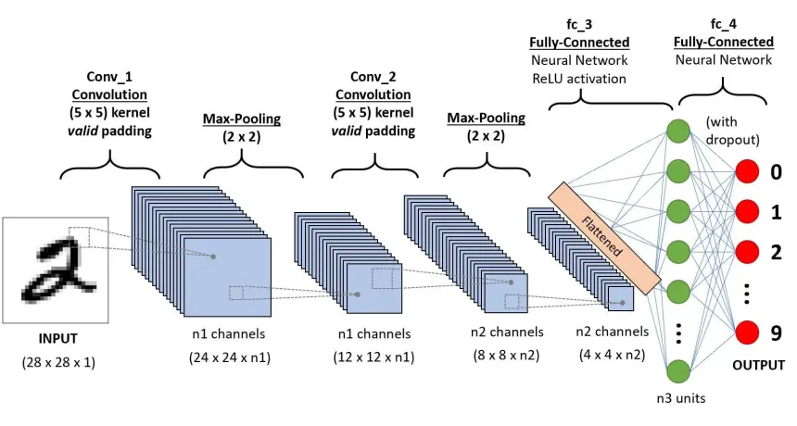
CNN ARCHITECTURE
https://www.analyticsvidhya.com/blog/2020/10/what-is-the-convolutional-neural-network-architecture/

Slide 15
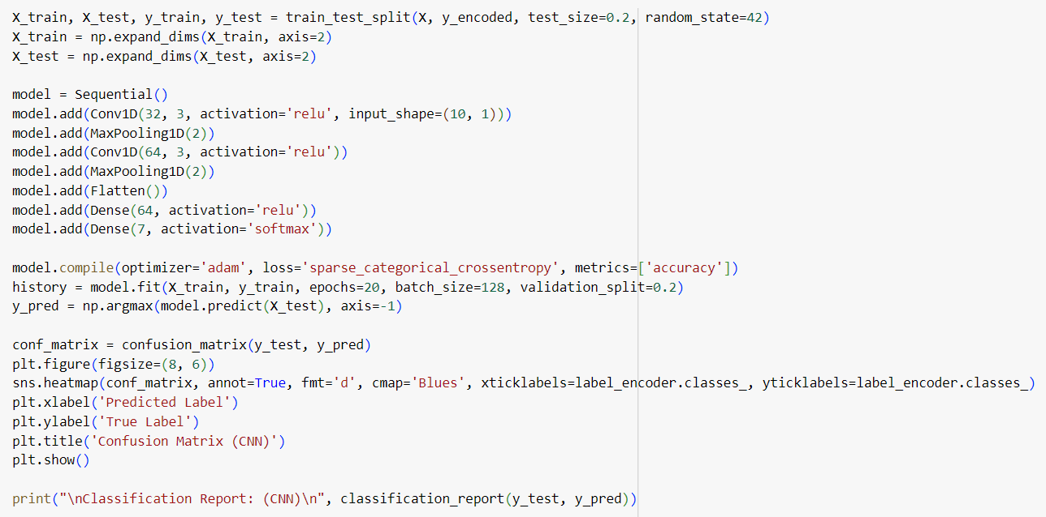
CNN CODE

Slide 16
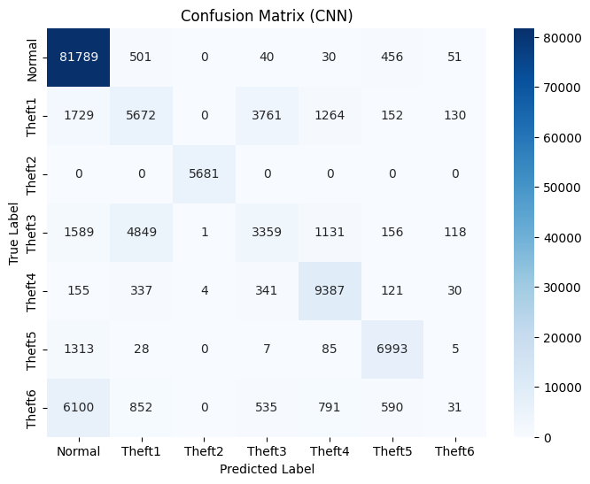
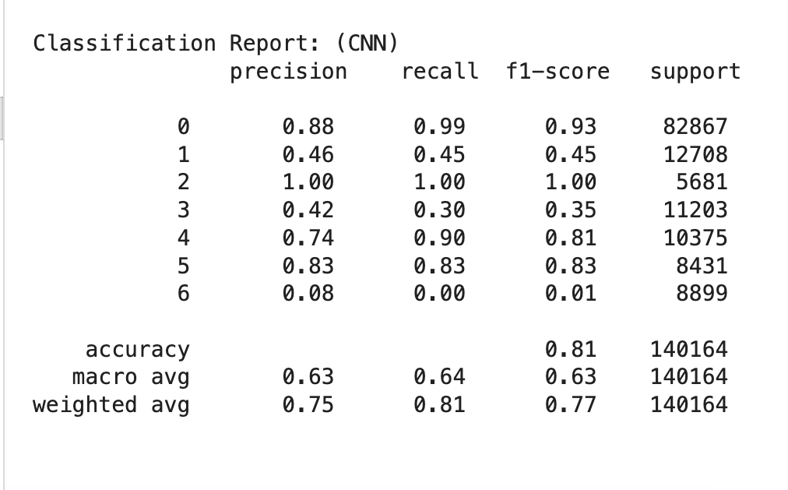
MODEL RESULTS (CNN)

Slide 17
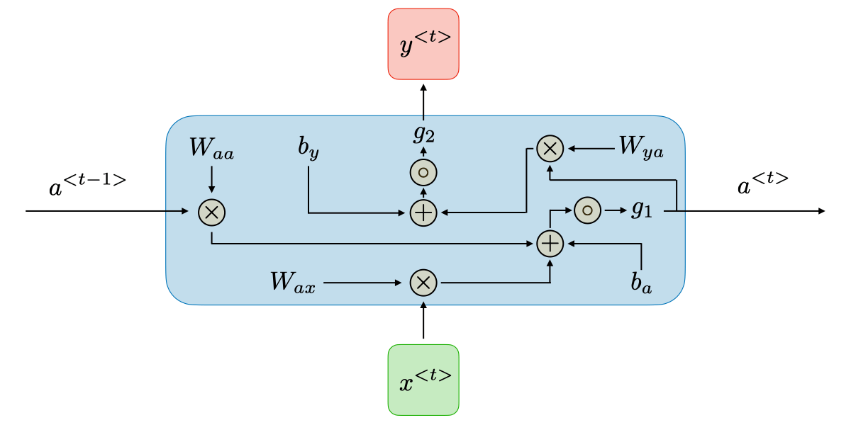
RNN ARCHITECTURE

Slide 18
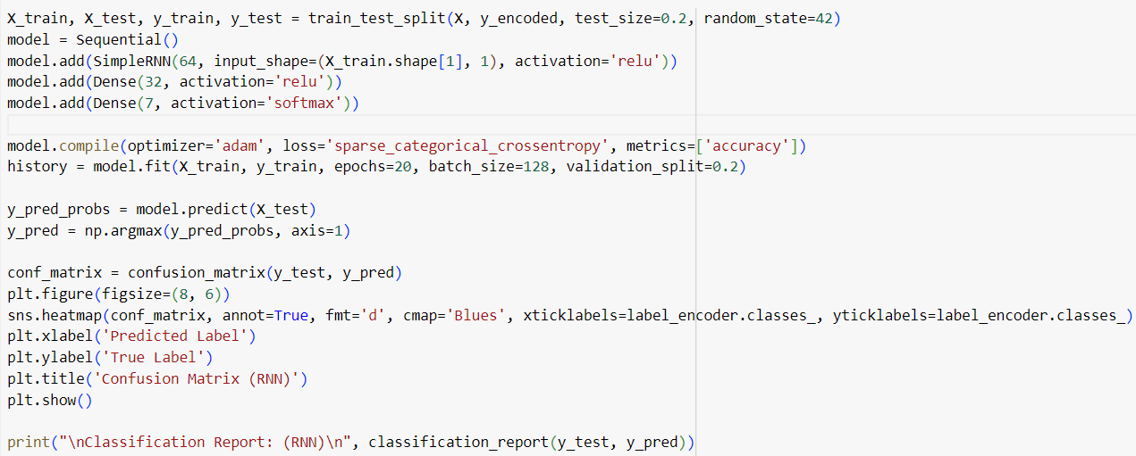
RNN CODE

Slide 19
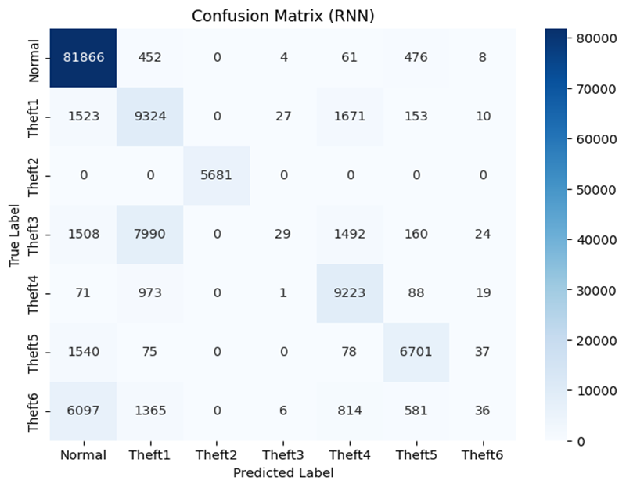
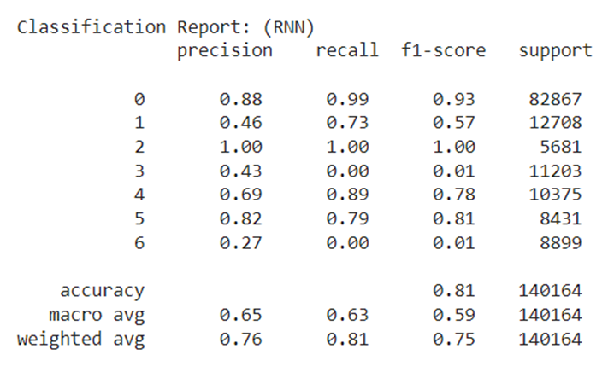
MODEL RESULTS (RNN)
Prediction on the test data set

Slide 20

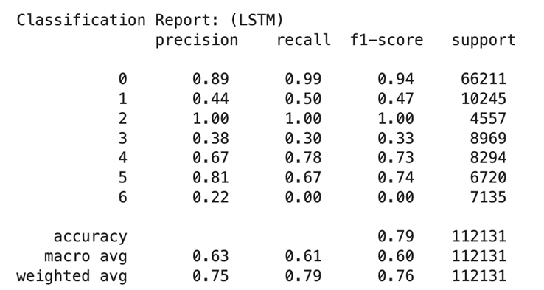
MODEL RESULTS (LSTM)
Prediction on the test data set

Slide 21
COMPARISON BETWEEN MODELS
TEST DATA |  | RANDOM FOREST | XGBOOST | KNN | RNN | CNN | LSTM
 | NORMAL | 0.93 | 0.93 | 0.91 | 0.88 | 0.88 | 0.89
 | THEFT 1 | 0.69 | 0.54 | 0.58 | 0.46 | 0.48 | 0.44
 | THEFT 2 | 1.00 | 1.00 | 1.00 | 1.00 | 1.00 | 1
PRECISION | THEFT 3 | 0.70 | 0.52 | 0.51 | 0.43 | 0.46 | 0.38
 | THEFT 4 | 0.86 | 0.69 | 0.69 | 0.69 | 0.74 | 0.67
 | THEFT 5 | 0.92 | 0.88 | 0.85 | 0.82 | 0.83 | 0.81
 | THEFT 6 | 0.05 | 0.21 | 0.16 | 0.27 | 0.10 | 0.22
ACCURACY | THEFT | 0.85 | 0.84 | 0.83 | 0.81 | 0.81 | 0.8

Slide 22
CONCLUSIONS
All the models have a high accuracy of greater than or equal to 80%.
Random Forest has the highest accuracy (85%). However, it completely fails in identifying Theft6 as the precision score is only 5%.
The accuracy of CNN is 81% but it fails to identify Theft6 as the precision (8%) is very low.
XGBoost, k-NN and LSTM have accuracies 84%, 83% and 80% respectively, and all the 3 of them have the ability to classify Theft6 relatively better than CNN and Random Forest as their precision values of Theft6 label are 21%, 16% and 22%.

Slide 23
CONCLUSIONS
RNN has an accuracy of 80% and is the model that best identifies Theft6 compared to all other models that have been tested with as the precision of Theft6 identification is 27%. However, its ability to identify Theft1 and Theft3 is poor compared to other models.
Therefore, XGBoost is the best model as it not only has a high accuracy but also identifies Theft6 equally well at the same time compared to other models.

Slide 24
FUTURE SCOPE
Smart meters are still not used by the majority of consumers. As smart meters penetrate the market further, more data can be mined. To handle this data, more complex neural networks have to be built. Big Data Analytics can be used.
Theft6 which reverses the readings of the smart meters is a deceptive theft as most of the existing models still fail to identify it. The best possible precision attained is 27% by Long Short Term Memory Deep Learning Model.
Theft3 which multiplies each electrical equipment consumption with a different random number between 0.1 and 0.8 is more complex (compared to Theft1 where all the electrical equipment consumption is multiplied by the same random number between 0.1 and 0.8) and is therefore not getting classified properly by most of the models other than Random Forest which heavily misclassified Theft6 (precision 5%).

Slide 25
REFERENCES
Dataset: https://data.mendeley.com/datasets/c3c7329tjj/1
Y. Wang, Q. Chen, T. Hong, and C. Kang, “Review of Smart Meter Data Analytics: Applications, Methodologies, and Challenges,” in IEEE Transactions on Smart Grid, vol. 10, no. 3, pp. 3125-3148, May 2019, doi: 10.1109/TSG.2018.2818167.
https://ieeexplore.ieee.org/abstract/document/8322199
S. Zidi, A. Mihoub, S. M. Qaisar, M. Krichen, and Q. Abu Al-Haija, “Theft detection dataset for benchmarking and machine learning based classification in a smart grid environment,” in Journal of King Saud University – Computer and Information Sciences, Received 21 February 2022, Revised 12 April 2022, Accepted 11 May 2022, Available online 17 May 2022.
https://www.researchgate.net/publication/360554845_Theft_Detection_Dataset_for_Benchmarking_and_Machine_Learning_based_Classification_in_a_Smart_Grid_Environment
R. Punmiya and S. Choe, "Energy Theft Detection Using Gradient Boosting Theft Detector With Feature Engineering-Based Preprocessing," in IEEE Transactions on Smart Grid, vol. 10, no. 2, pp. 2326-2329, March 2019, doi: 10.1109/TSG.2019.2892595.
https://ieeexplore.ieee.org/stamp/stamp.jsp?tp=&arnumber=8610248
Z. A. Khan, M. Adil, N. Javaid, M. N. Saqib, M. Shafiq, and J. G. Choi, “Electricity Theft Detection Using Supervised Learning Techniques on Smart Meter Data,” in Sustainability, vol. 12, no. 19, pp. 8023, September 28, 2020, doi: 10.3390/su12198023.
https://www.mdpi.com/2071-1050/12/19/8023
J. Y. Kim, Y. M. Hwang, Y. G. Sun, I. Sim, D. I. Kim, and X. Wang, “Detection for Non-Technical Loss by Smart Energy Theft With Intermediate Monitor Meter in Smart Grid,” in IEEE Access, vol. 7, pp. 129043-129053, September 11, 2019, doi: 10.1109/ACCESS.2019.2940443.
https://ieeexplore.ieee.org/stamp/stamp.jsp?tp=&arnumber=8832141

